Slide 1
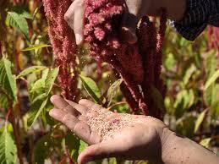
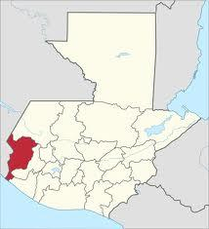

Guatemala Amaranth
Project
Alan, Carolyn, David, Jessica, Kerri, Matthew
Business on the Frontlines

Slide 2
Agenda
So What?
Current Consumption/Production
Markets
Methodology
Appendix
Overview & Project Goals
What we know now
What we want to know
How we will learn

Slide 3

So What?
So What?

Slide 4
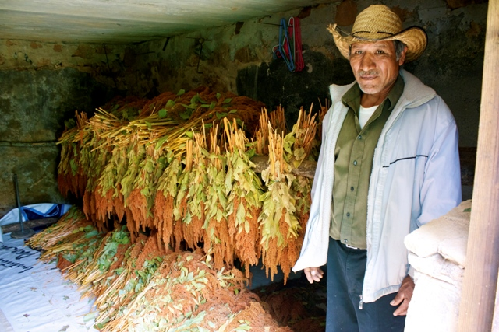
Problem Statement
How might we use Amaranth to improve nutrition among poor farming families in rural San Marcos, Guatemala?

Slide 5
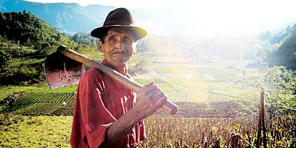
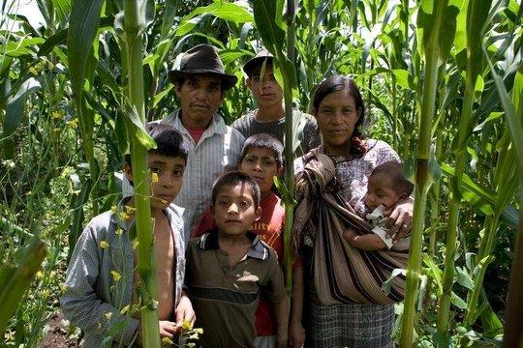
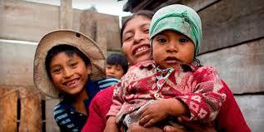
Those We Serve
San Marcos Region
85% of population lives in poverty or extreme poverty
Highest rate of malnutrition among children under five in Latin America (Oxfam)
Malnutrition rate is close to 70% for indigenous children (World Food Program)
Dietary staple is corn

Slide 6
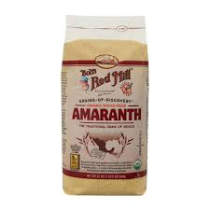
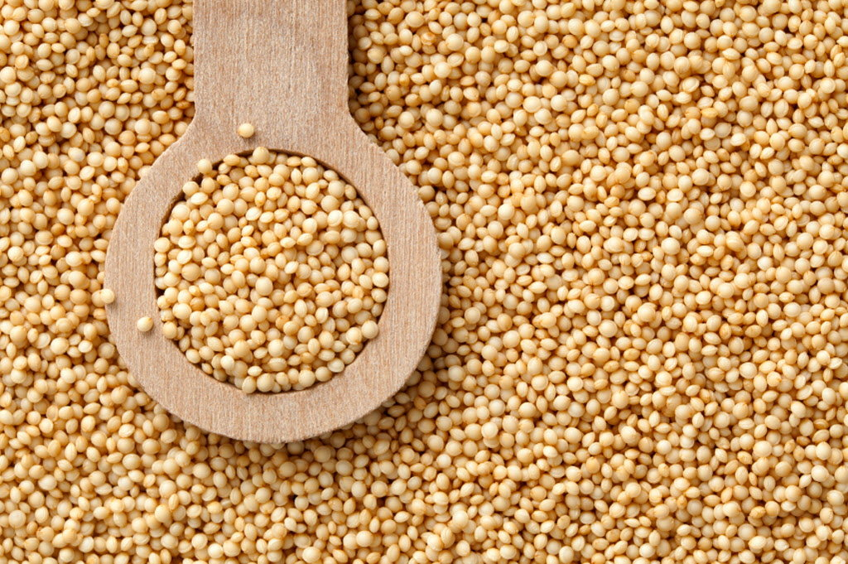
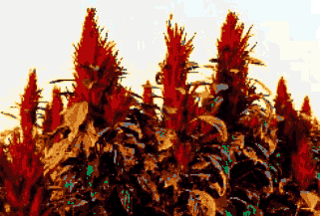
Amaranth: The Aztec Superfood
Former staple destroyed by Spanish Conquistadors -1500s
Grain W/ 15% Protein & Key Amino Acids
Drought Tolerant & Adaptable
Grind into Flours – Maintain Taste w/ 75%mix
Attractive Market Price for Farmers
C4 Plant
Notes:
Teaching notes should encourage further research into the export/value chain of the banana, complexities thereof.

Slide 7
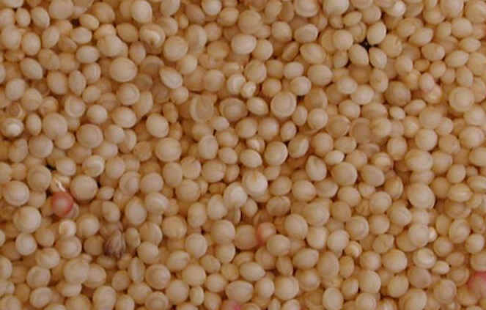

Scope of Work
Client: Catholic Relief Services (CRS), Guatemala
Funding: CRS 6-year Title II Grant (2012-2018)
Title II Project Goals
Reduce chronic malnutrition
Improve health environment
Increase agricultural production
Title II Project Activities
Distribute food
Strengthen community environment
Promote amaranth cultivation
Connect to markets
BOTFL Team Deliverables
Business plan for a small producer and producer organization for national sales
Characterize the current state of the amaranth market in Guatemala including growth potential and marketing recommendations

Slide 8
How We Break Down the Project
Individual/Family Demand Level
Will people eat it? Buy it? Value it?
Small Farmer Production Level
Can CRS convince risk-averse farmers to switch?
Local Market Level
What does it take to bring amaranth to market?
International Market Level
Is export viable? Does it help or hinder the project goals?

Slide 9
Local Consumption
Local Consumption
Current Consumption & Agricultural Production

Slide 10
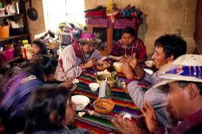
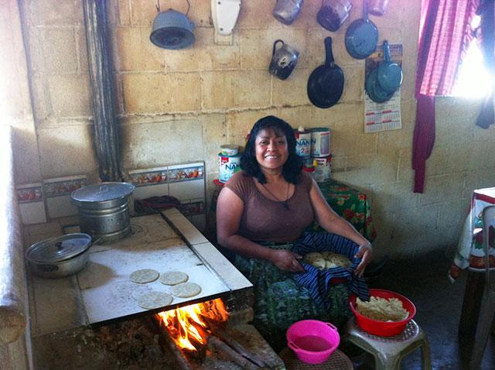
What is the current diet?
Typical Daily Menu
Breakfast: Coffee, black beans, tortillas
10 am snack: Atole (sweet corn drink)
Lunch/Dinner: Corn, tortillas, black beans (refried,whole, mashed),
rice, eggs, cheese, chicken, turkey, beef, stew
Drinks: Coffee, aguas, licuados
Additional Dishes:
Bistec
Guacamole
Mosh (porridge)
Pepián (meat/veggie stew)
Variety of fruit/vegetables

Slide 11
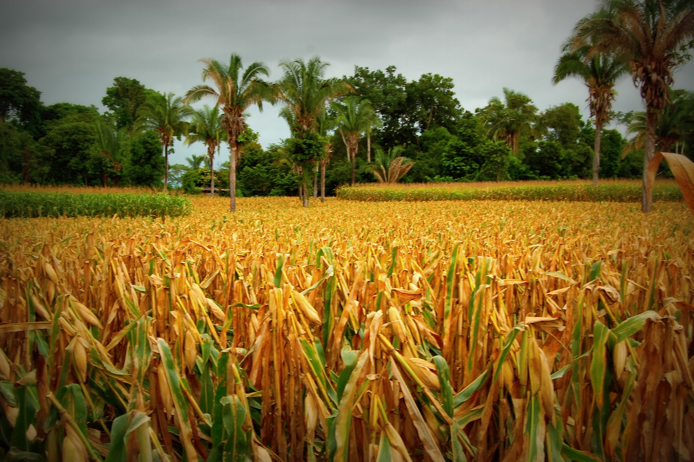
Guatemalan Agriculture: Corn
Corn is the primary staple crop (beans #2)
Maize (non-sweet corn) and elote (sweet corn)
C4 crop: drought tolerance
Low labor, no sophisticated processing required
80-90% of production is consumed locally ⇒ want to connect to markets
Typical Farming - Small rented plots
Notes:
Challenge group to think about what the constraints are – want them looking at constraints that go beyond resources: social? principles? CRS has many.

Slide 12
Economics of Corn
Planting
Cultivation & Harvesting
Processing
& Storage
Consumption &
Sale
Credit $
Land
Seed
Labor
Weather
Fertilizer
Pesticide
Irrigation
Tools & Supplies
Labor
Other…?
Sorting
Drying
Storing
Processing
Quality Control
Transportation
Consumption
Sale at local markets
Quick Facts…
90% of current corn yield is consumed, 10% is saved for seed for next year’s crop
Corn is only sold to market in years of high yield
Corn is low-risk for our beneficiaries – They have the tools, knowledge, and habits

Slide 13
Economics of Amaranth
Planting
Cultivation & Harvesting
Processing
& Storage
Consumption &
Sale
Credit $
Land
Seed
Labor
Weather
Fertilizer
Pesticide
Irrigation
Tools & Supplies
Labor
Other…?
Sorting
Drying
Storing
Processing
POPPING
Quality Control
Transportation
Consumption
Sale at local markets
Example: Amaranth in Mexico
Sale Price x Yield - Total Costs = Profit
$2/kilo 1200 kilo/ha $1400/ha $1000/ha

Slide 14
Markets
Domestic & International Markets

Slide 15
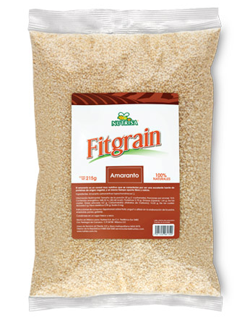
Domestic Markets: Hypotheses
Domestic amaranth sales are primarily specialtiy
stores (Expats,etc)
Through creative partnerships (govt, church, communities), we may be able to boost demand & expand market
May be able to capture more of the value chain with post-processing
Equipment would help
Farmers may be able to utilize intermediaries in place for high yield corn seasons

Slide 16
Domestic Markets: Potential Challenges
May be issues with infrastructure
Intermediaries/transportation networks may not be firmly established due to local consumption
Food is currently sold only when yields are high
If farmers are only growing a portion of their fields as amaranth, distance may be prohibitive
Oversight by the Ministerio de Agricultura, Ganadería y Alimentación de Guatemala
Other Risks
Notes:
makes me think we should make sure that those sort of visits are in our country tour? ← Jess?
also what about researching diet in G city?

Slide 17

Current Export Picture
Guatemalan International Market Context
Exports – $9.2 Billion
Imports – $10.6 Billion
Export partners
US 40.2%, El Salvador 11.1%, Honduras 8%, Mexico 5.5%, Nicaragua 4.7%, Costa Rica 4.3%
Export Agriculture
12% sugar, 9% coffee, 6% bananas, 3.4% nutmeg*
Import partners
US 38%, Mexico 11.3%, China 7.4%, El Salvador 4.6%
Import Agriculture
Corn seed (1.28%) Wheat and Meslin (1.07%
Notes:
Challenge group to think about what the constraints are – want them looking at constraints that go beyond resources: social? principles? CRS has many.

Slide 18


International Markets: Hypotheses
Health food seekers would be the target end-user
Post-processing opportunities would be much the same as Guatemala market
Can find Amaranth in popped form in Euro markets
Potential to partner with existing amaranth exporters in Guatemala
Likely will not be problems with the FDA
Most violations occur with produce & seafood

Slide 19
International Markets: Potential Challenges
Most of the same barriers to domestic markets will also apply internationally
Price
Amaranth appears to be cheaper in the US and Europe than in Guatemala
May not be able to produce adequate supply

Slide 20
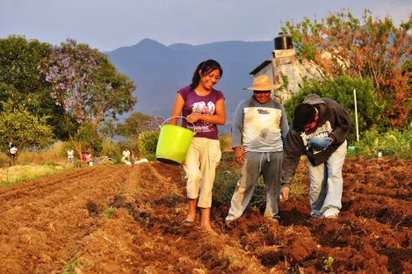
What we plan to learn in Country
We need to learn about the existing structure of getting ag products to market.
We want to trace the value chain backwards and forwards.

Slide 21
Methodology - Getting Info
Methodology - Getting Info

Slide 22
Our Research Methodology
Secondary Research
Expert interviews
In-Country visits to every step along the value chain
Design-Thinking approach to understanding end-consumers

Slide 23
Progress So Far
Expert Interviews
Braden Weldy - Farming Technology
Matt Maye - Gourmet Food Markets
Anna McKeever - Guatemala
Hal Culbertson - Dietary Change
Matt Bloom – Design Thinking
Pete Noll – Mexican Amaranth Project
Secondary Research
US AID Title II
Amaranth Institute
Guatemalan Context
Other

Slide 24
In Country Research Plan – Finding what we need
Week 1:
Antigua: observation
Guatemala City: CRS, USAID, AGEXPORT, Chickakh, Artesano, Productos Integrales y Organicos, Compadores de mais, Asociación Ripalamax
Rabinal: Asociación Qachuu Aloom, amaranth production
Panajachel: Grupo Oxlajuj E, El Tablón, Solola; amaranth production
Week 2:
Group 1 - San Marcos:
Focus on corn: Comunidades Tejutla, Comitancillo y Sipacapa (Consumer & Farmer)
Group 2 - Nebaj Quiche:
Focus on amaranth: Asociación Kulbaalib Xechulub (Consumer & Farmer)
Final CRS Presentation
Panama: GE Visit

Slide 25
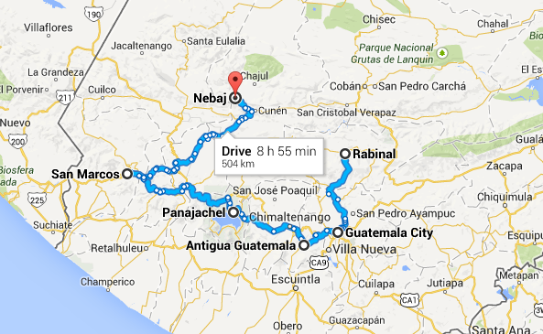

Slide 26


Individual Consumer Level Research Question: How difficult is switching?
Best and worst practices - Case studies:
Long-term process: needs long-term programming.
Behavior change takes time and may not be adopted as expected.
Methods for behavior change/adoption:
Positive Deviance- Core Group of early adopters—the “outliers” become ambassadors
The Hearth Model: Local solutions, Participatory learning, Seeing is believing
(Share what they are doing, culturally relevant, economically feasible)
Puente uses the methodology of “intercambios”
Assessment: What is the community is looking for?
Create a common goal: Monitoring and evaluation system. How do we define success?
Approach two farmers in different methods:
Differences between farming to eat (food security) / sell (to make money)
…..Therefore, we must learn deeply about our users

Slide 27
DEMAND: Two Possible Scenarios
Scenario A: Consumers Value Benefits of Amaranth
CRS Uses Education & Other Tools to Generate Consumer Demand for Amaranth
Farmers Phase-Out Corn for Amaranth, Market Develops, Scale is Achieved.
Scenario B: Consumers “Just Not That Into” Amaranth
Consumer Demand slowly grows as prices fall, awareness rises, and CRS promotes it (i.e. marketing)
CRS Partners with Institutions (Schools, Prisons) to Bridge Gap in Consumer Demand
Farmers Phase-Out Corn for Amaranth, Market Develops, Scale is Achieved

Slide 28

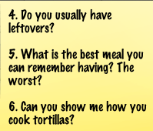
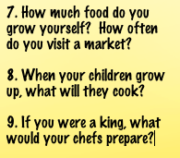
Our Research Plan: Dietary Change
Design-thinking - study relationships with food/diet.
Days 10 & 11 will be spent visiting kitchens & farms
We’ll do focus groups, interviews, and cook together
Goal: Feasibility assessment and info for use in marketing/product positioning/demand generating

Slide 29
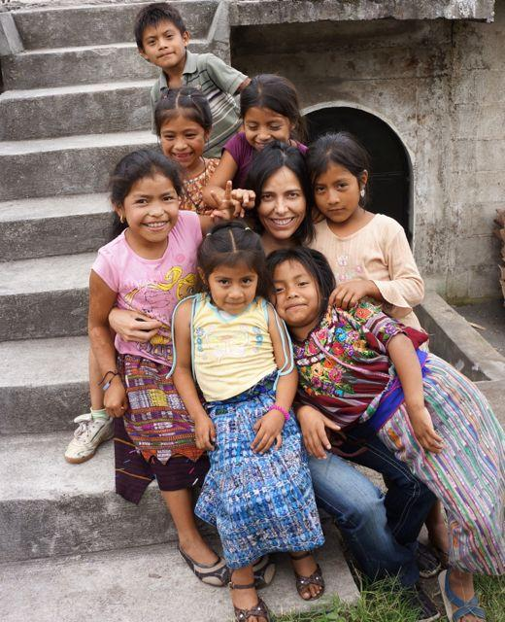
Interview Protocol
Interview protocols and templates guide; ethnographic research
Protocol walks through introduction, interview, and conclusions
Interview questions determined by context and participants
Local farming families (males, females, children)
ECADIs & CRS/Caritas local staff
CRS national staff
Economic partners (intermediaries, retailers, exporters, etc.)
Daily team synthesis to process interviews

Slide 30
Methodology - Getting Info
Appendix

Slide 31

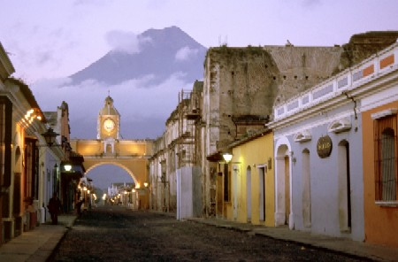

It’s okay to have a good time…
Antigua, Atitlan, Volcanoes

Slide 32
Guatemala Organizations
Organization | Web | About
Chikach | http://chikach.com/ | Brand of local/organic products
AGEXPORT | http://export.com.gt/en/#/inicio | Association of Guatemala Exporters
Artesano | http://www.artesano-inc.com/quienes-somos.php | Food company that provides 100% vegetarian products
Productos Integrales y Organicos | www.integralesyorganicos.site88.net
Compadores de mais
Asociación Ripalamax

Slide 33
Guatemala Organizations
Organization | Web | About
Asociación Qachuu Aloom
Grupo Oxlajuj E
USAID | http://www.usaid.gov/where-we-work/latin-american-and-caribbean/guatemala

Slide 34
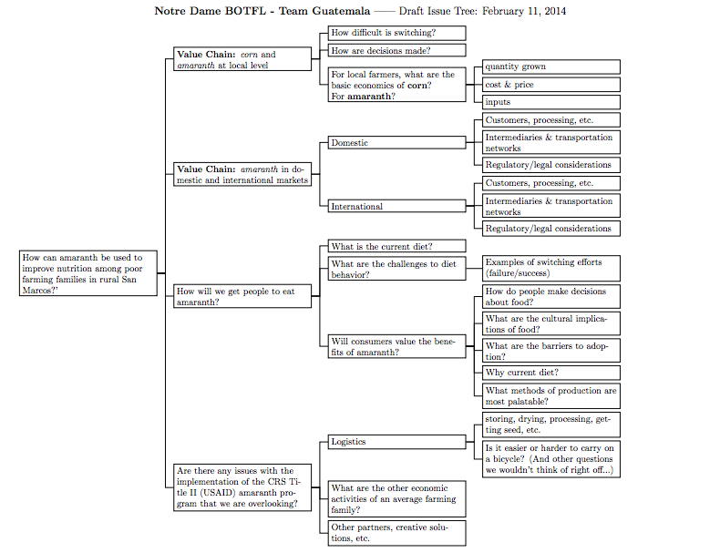

Slide 35
Issue Tree
PDF Link:
https://dl.dropboxusercontent.com/u/31826395/Issue%20Tree%202.pdf

Slide 36
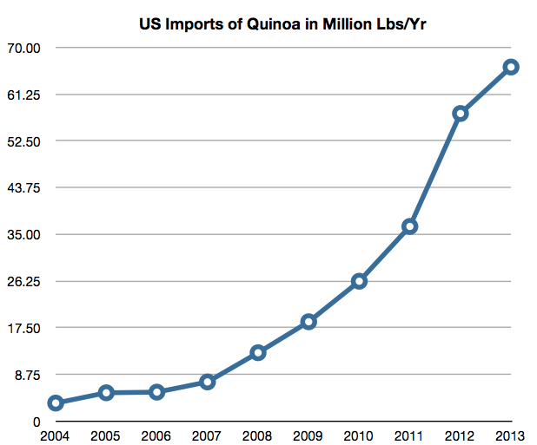
Quinoa
We consider Quinoa a model to learn from
Similarities:
Super Grain from South/Central America
Gluten-Free
Both eaten by pre-Columbian indigenousness Peoples
Notes:
Challenge group to think about what the constraints are – want them looking at constraints that go beyond resources: social? principles? CRS has many.

